Slide 1
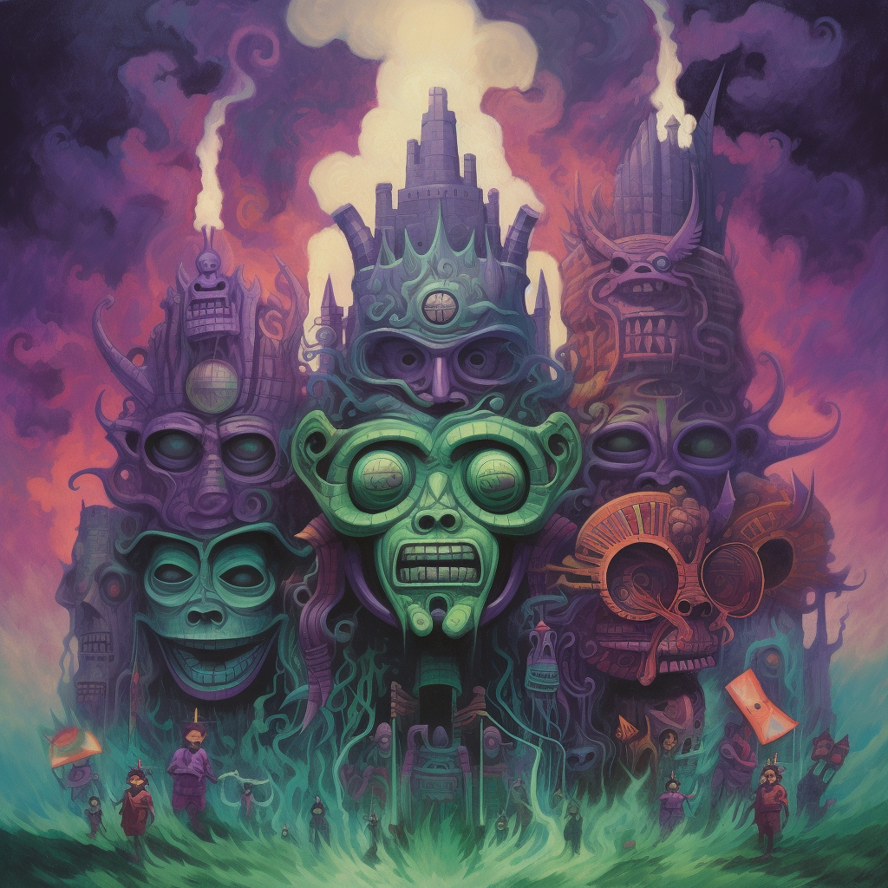
INCURSION
CHARACTER MOODBOARDS

Slide 2
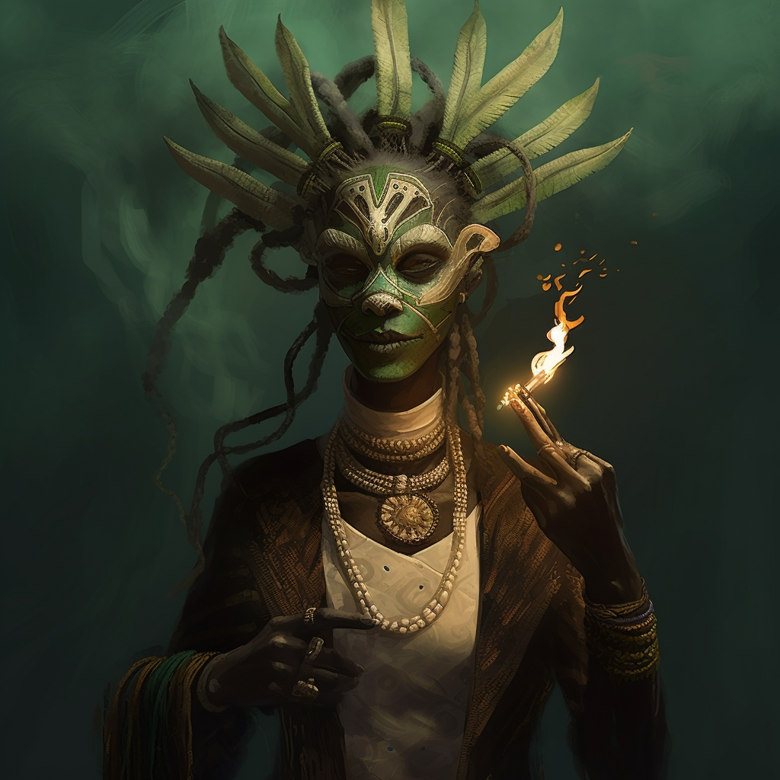
PROTAGONIST
FEMALE, AGE 27
AFRICAN ORIGIN
Mix of modern wear and tribal African elements
The feathered headdress and mask are the iconic piece
Since the game is isometric viewed from above at an angle this needs to stand out
This game will be on mobile and PC and will not need high fidelity textures and very high poly characters to save on resources.

Slide 3
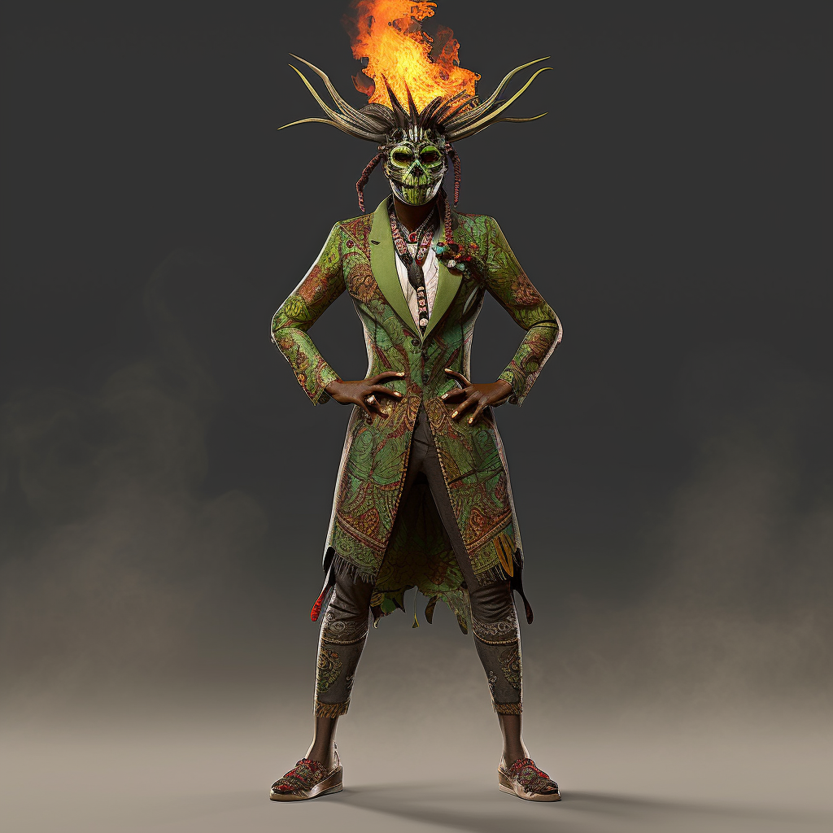
PROTAGONIST
KEY ELEMENTS
HAIR:
Dreadlocks that fall out of the mask
No need to rig / animate
THE MASK / HEADRESS
The Face: A wooden mask painted with tribal designs – see previous slide.
The Headdress – Feathers or horns in framing the top part of the head
No fire !!
CLOTHING
A mixture of tribal and modern wear
Long coat, with an intricate tribal design
White top
Fitting leggings with the same design
Open sandals
JEWELLERY
A thick bone and cloth necklace colored in

Slide 4
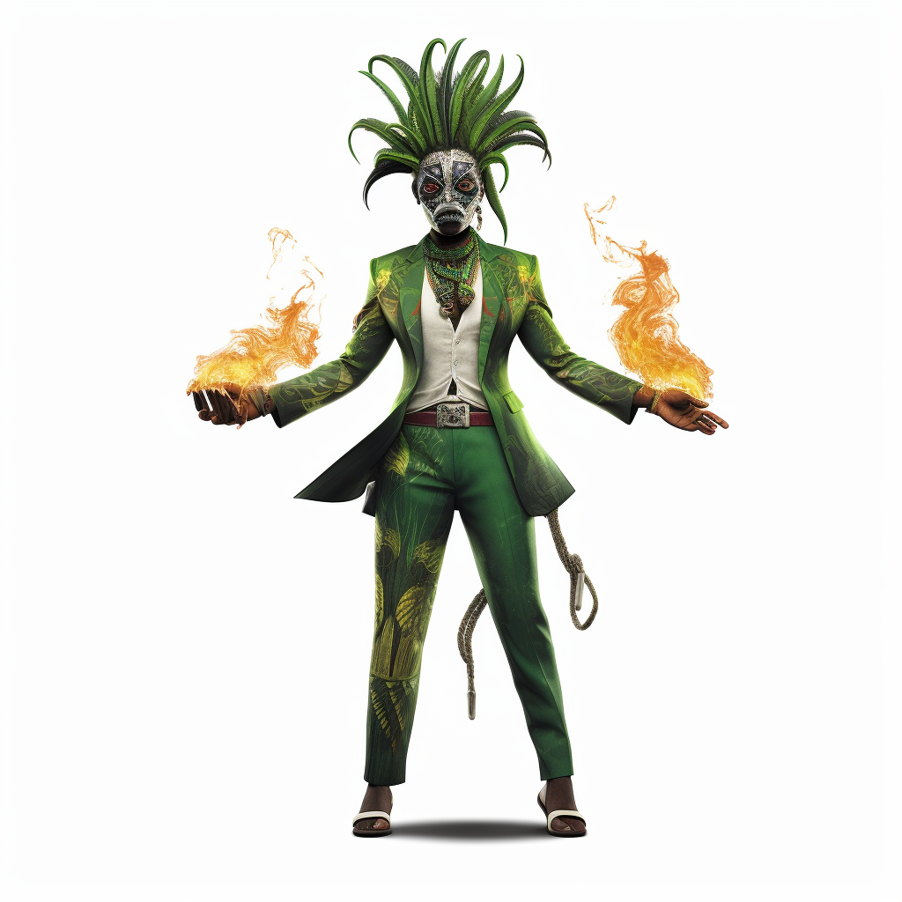
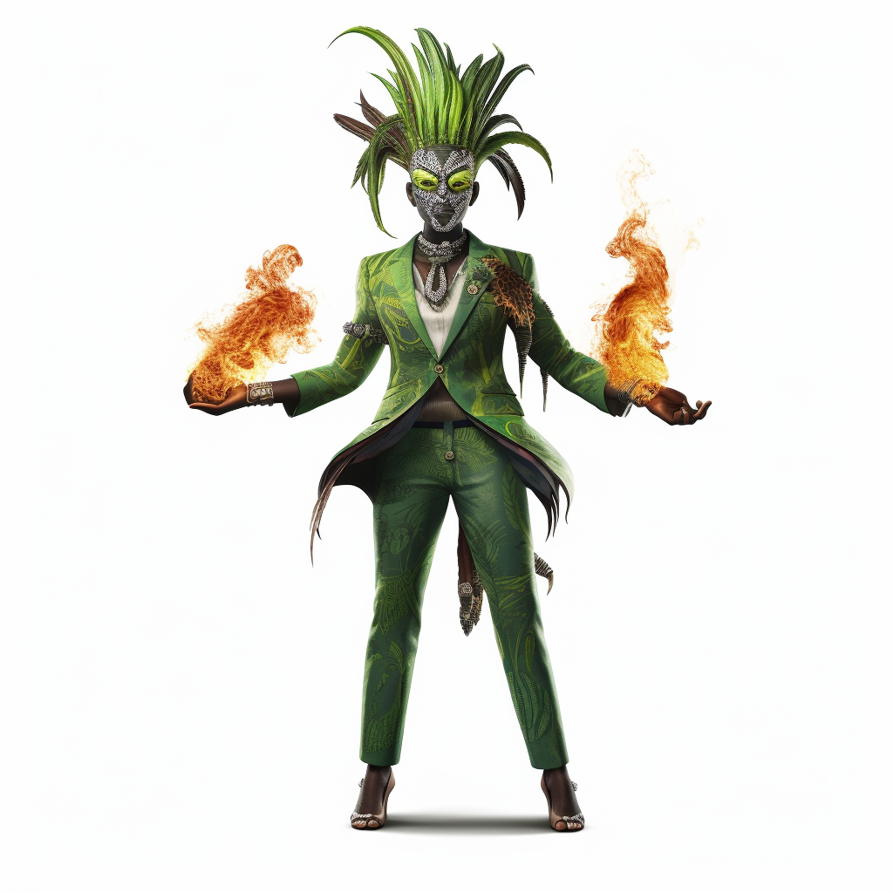
VARIANTS
These should help you visualize the intended outcome better

Slide 5
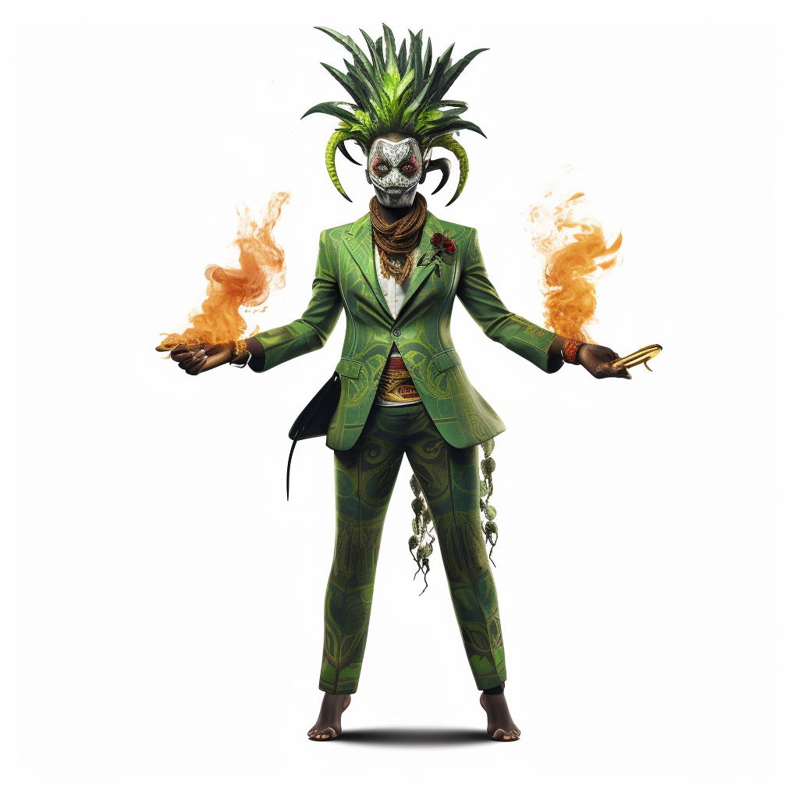
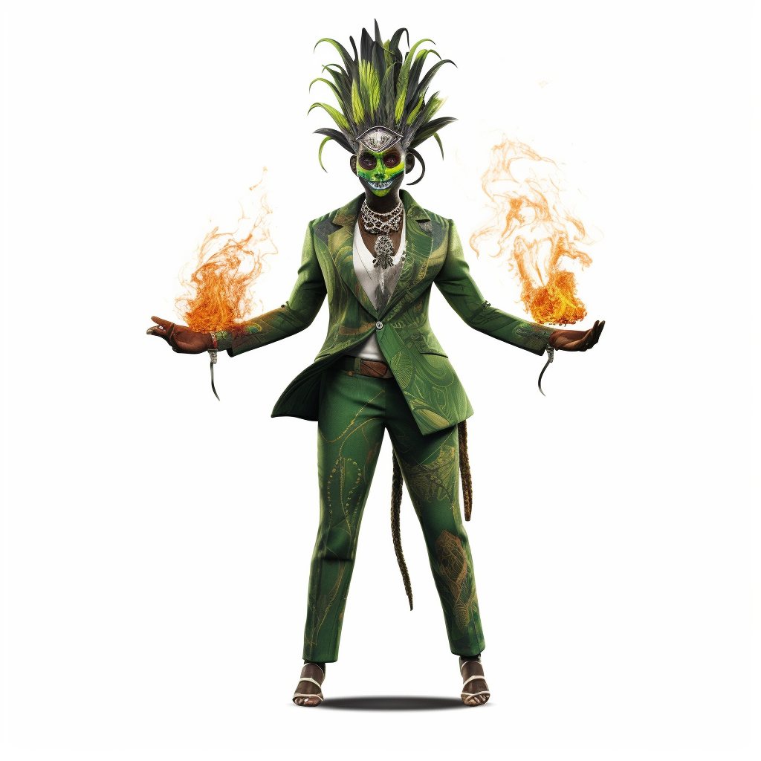
VARIANTS
These should help you visualize the intended outcome better

Slide 6
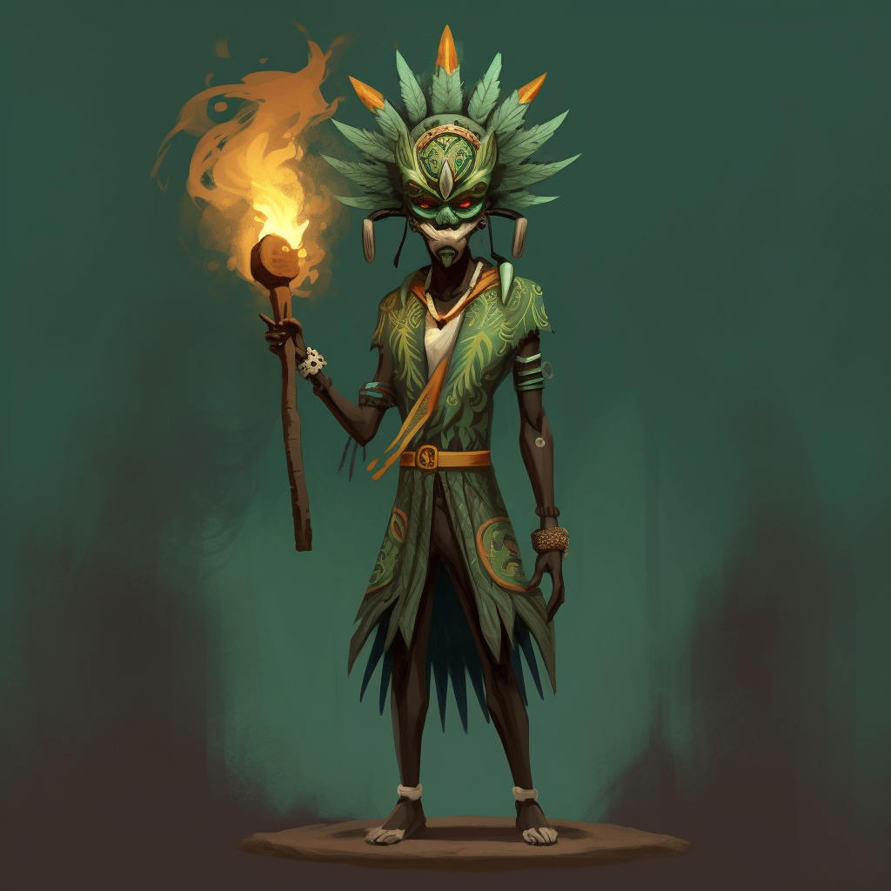
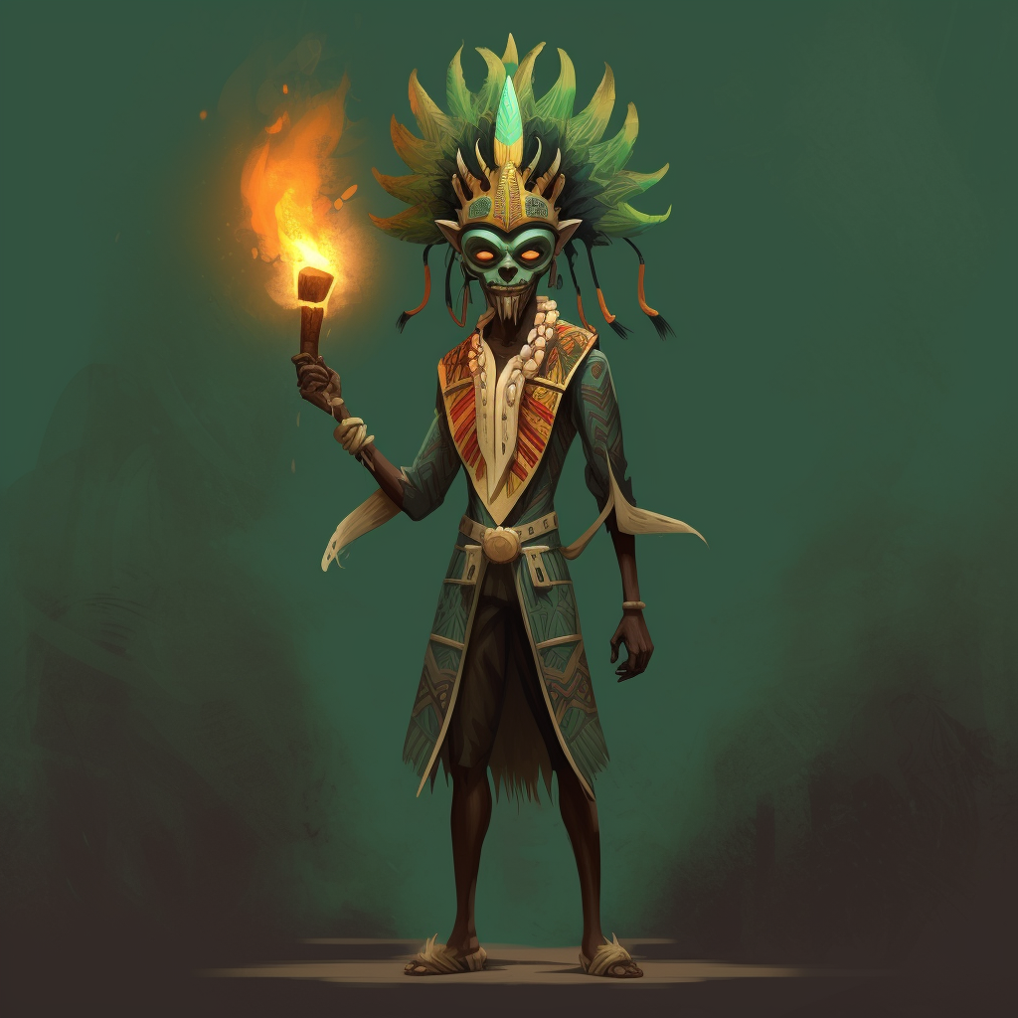
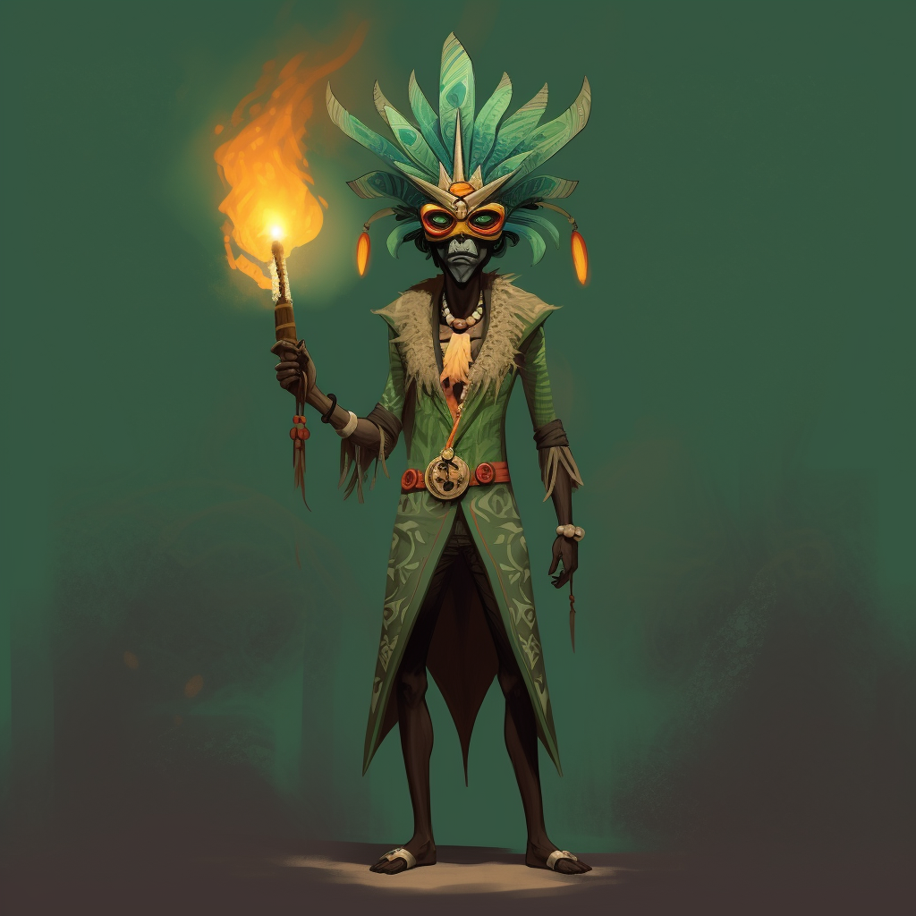
QUALITY AND TEXTURE STYLE
We will not be going for realistic graphics but more a vibrant cartoon style
This previous concept for the protagonist should give you an idea of the level of detail

Slide 7
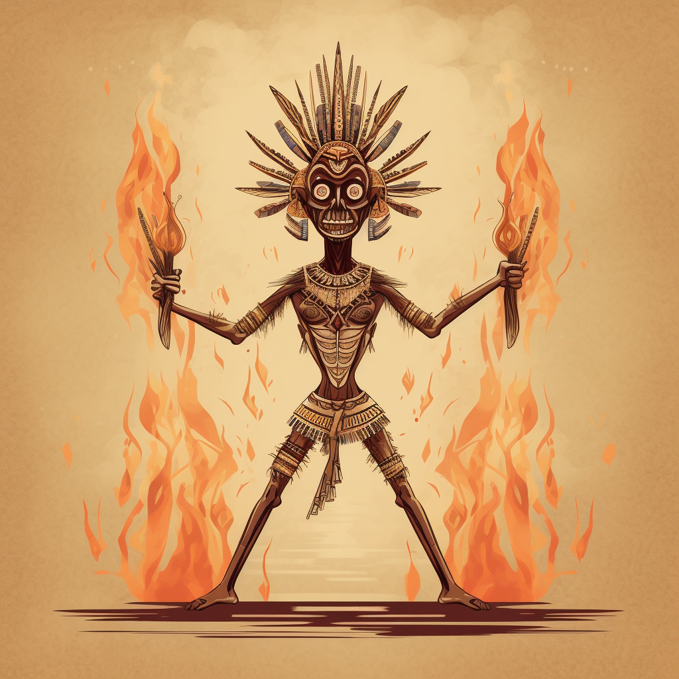
ANTAGONIST
For the prototype we will be using this enemy
Its job is to rush the player and then cast a cone of fire .
Explodes on death

Slide 8
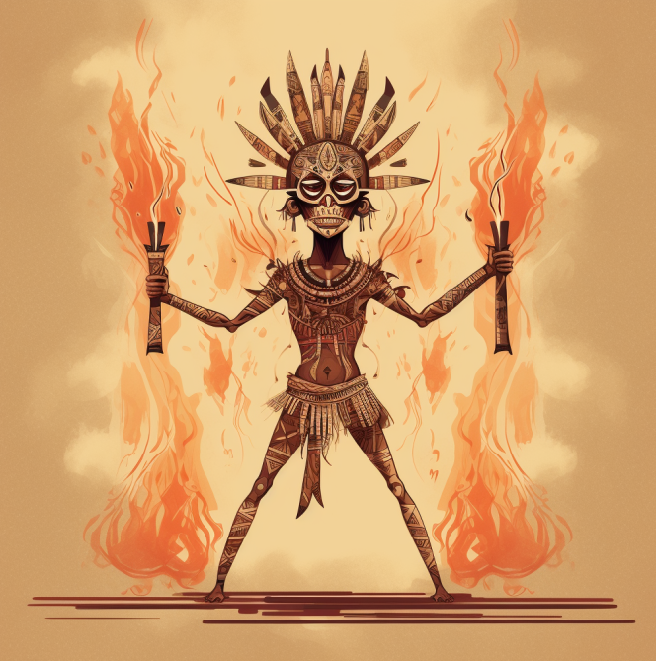
THE MASK / HEADRESS
Disproportionately large mask for his body
The Headdress – Feathers or horns in framing the top part of the head
BODY
Inhumanly thin covered in white tattoos
Props
Holds two fire sticks

